Slide 1
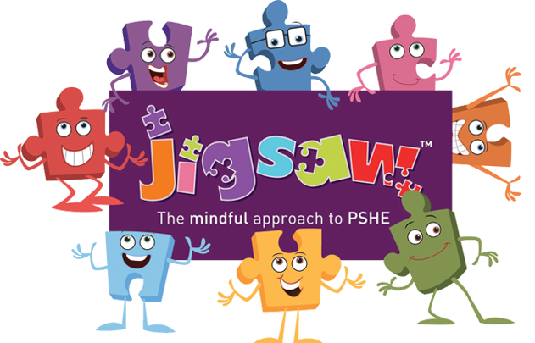
RSE Curriculum
Term 6 – Changing Me

Slide 2
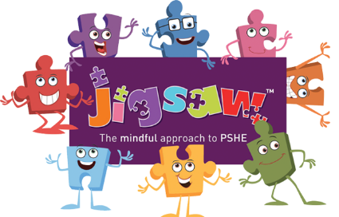
Year 1
Lesson 1 | Life cycles of animals and humans
Lesson 2 | Things that have changed about me and the things that have stayed the same
Lesson 3 | How my body has changed since I was a baby
Lesson 4 | Boys and girls body parts – using the correct names
Lesson 5 | Every time I learn something new I change a little bit
Lesson 6 | Changes that have happened in my life

Slide 3
Year 2
Lesson 1 | Life cycles in nature
Lesson 2 | Natural process of growing from young to old
Lesson 3 | How my body has changed since I was a baby – continuum from young to old
Lesson 4 | Physical differences between boys and girls – use correct names. Parts of the body are private
Lesson 5 | Different types of touches e.g. cuddles – likes and dislikes
Lesson 6 | Looking ahead to my next class

Slide 4
Year 3
Lesson 1 | Changes that happen in animals and humans
Lesson 2 | What babies need to live and grow
Lesson 3 | Boys’ and girls’ outside body changes
Lesson 4 | Boys’ and girls’ outside body changes
Lesson 5 | Stereotypical ideas relating to parenting and family roles
Lesson 6 | Looking ahead to my new class

Slide 5
Year 4
Lesson 1 | Unique me – personal characteristics
Lesson 2 | Girls’ body changes – having periods
Lesson 3 | Personal hygiene
Lesson 4 | Circles of change
Lesson 5 | Accepting change – changes that I can and cannot control
Lesson 6 | Looking ahead to my new class

Slide 6
Year 5
Lesson 1 | Self image and body image
Lesson 2 | Puberty for girls
Lesson 3 | Puberty for boys
Lesson 4 | Conception
Lesson 5 | What am I looking forward to about becoming a teenager?
Lesson 6 | Looking ahead to my next class

Slide 7
Year 6
Lesson 1 | My self image
Lesson 2 | Puberty – looking after myself physically and emotionally
Lesson 3 | Babies – conception to birth
Lesson 4 | Boyfriends and girlfriends – physical attraction
Lesson 5 | Real self and ideal self
Lesson 6 | The year ahead – transition to secondary school

